Slide 1



Application Roadmap
Srinivas Rayapeddi
October 20, 2005
Confidential Property and Information

Slide 2
Agenda
Purpose
From here to where?
J2EE Best Practices
Suggested IRI J2EE strategy
RAD, Build Process
SOA, Web sphere, Portal and other components
Documentation
Conclusion
Risks / Next Steps

Slide 3
Purpose
Purpose
  The intended purpose of this presentation is to help manage and develop J2EE applications @ IRI.
  Suggested technologies to use based on industry standards and implementation experience during Iteration-2
  Evangelize existing MK Java Framework components for company wide use.
  Identify Issues and/or Risks and suggested ways of mitigating them.

Slide 4
State of Affairs
In Iteration-2 the team developed framework features such as DAO using Hibernate, Search, Security, Error, Exception and Pagination.
Build components using Websphere App. Server and Portal 5.1
Installed & Configured Enterprise Service Bus for messaging
Documentation Methodology Established - Use case, Design and Architecture document collateral for projects.
Developed a CM & BUILD Process.

Slide 5
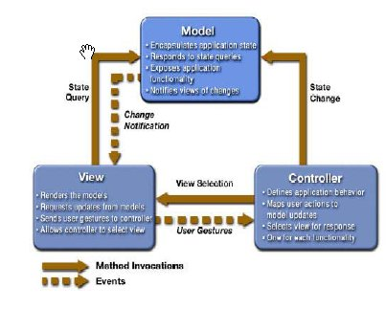
J2EE Best Practice – UI & MVC
Always use MVC
Cleanly separates Business Logic from Presentation
Good layering can cover multitude of sins
Websphere Portal uses Model – View – Controller. Leverage it!

Slide 6
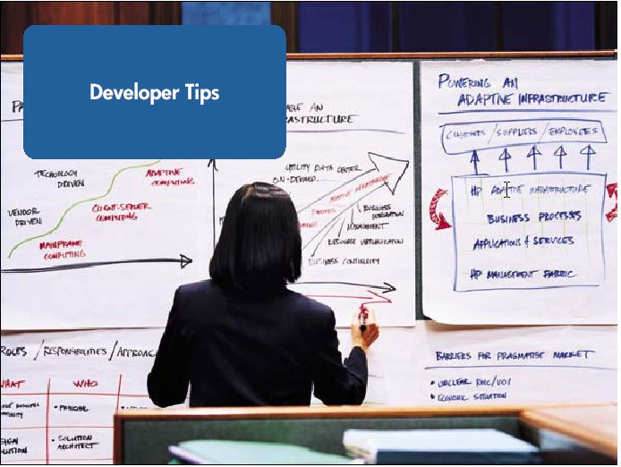
J2EE Best Practices (Business Framework)
Do You Need an EJB Tier?
Maybe not, for applications whose main function is
  reading database tables
Yes, if you want to leverage middleware features
  Resource management, concurrency control and
  Threading & Messaging
Use Design Patterns (i.e. Façade) to hide complexities
Use Message Driven Beans for loose coupling of Business Components

Slide 7




J2EE Best Practice – Object Persistence
Persistence Strategy has a great impact to J2EE performance. Choose the product and/or strategy wisely
Design for Database independence.
Ease of development is always important factor.
Make sure the tool you pick can support entity relationship modeling.
There are several J2EE persistence product in the market. Pick the one that suits your environment and wallet.
Don’t use raw JDBC API

Slide 8
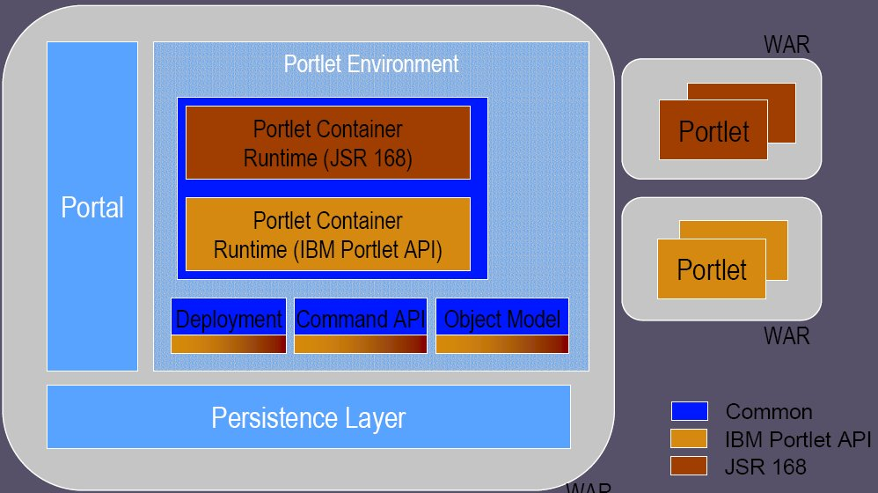
IRI J2EE Architecture for UI & MVC
IBM Websphere Portal 5.1 is the Web UI standard
Portal is inherently MVC and makes UI design quick, easy and portable.
Implement IBM basic portlets using JSR 168 standards. If build issues are resolved JSF portlet can be used.
Portal provides
  Security
  Session management
  Validation
  Pagination
  Caching
  Replaceable skins & CSS
Greater Productivity and cleaner UI implementations.
Use Portal for Web UI.

Slide 9
IRI J2EE Business Framework
Deploy your business components into the Portal or App Server container.
Use a lot of POJO (Plain Old Java Object) as Business Components
Avoid using heavyweight objects.
Connect to Hibernate layer using POJOs
Create a Façade Pattern for complex Business Components
If you are using an EJB as a Business Component, try to use a Stateless Session Bean
Avoid using Entity Bean. All DB Persistence should be handled through Hibernate

Slide 10

IRI J2EE – Object Mapping
Use of Hibernate for Object Persistence
Check and Support Team has developed a fully functional DAO layer over Hibernate.
Hibernate Scalable, Portable and popular O/R Tool with ZERO SQL in Java tier
Connectivity to Oracle and/or DB2 with a turn of a switch.
Provide strong entity relationship mapping.
For code examples, please consult Clearcase and DIV project

Slide 11
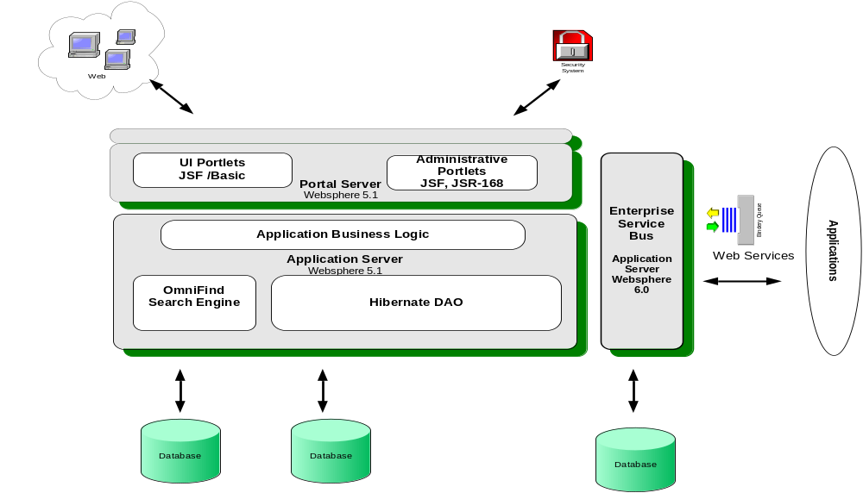
Suggested Technology Stack
ESB hosts all the web-services and UDDI directory
Portlets are built using JSR168 Standards

Slide 12
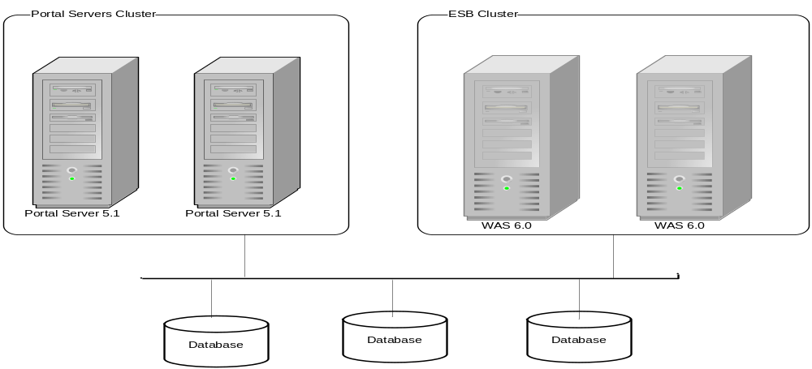
Suggested Deployment Model
Clustering enables high scalability and reliability
With clustering, failover or load balancing can be achieved without affecting the client or application developer
Additional server instances can be added dynamically
Provides flexibility of adding EJBs and Web-Services to the WAS cluster based on need.

Slide 13
Current Build & Development Process
ANT is the build and Unit Test tool of choice.
Check and Support Team has created a powerful build environment using ANT. (For example Check the tadpole vob in Clearcase)
Build environment integrated with Clearcase and Rational Developer Tool
Build portlets, business components, web services using Rational Developer 6.0
Use ANT to generate documentation and run JUnit test suites.
Isolate run-time environment variables in property files and have ANT manage the automated deployments.

Slide 14
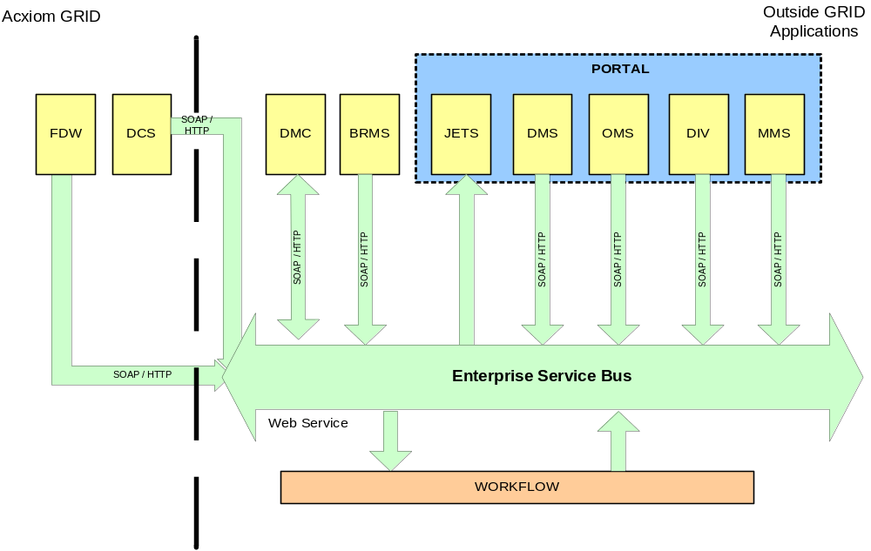
Suggested SOA Architecture

Slide 15
Suggested SOA Architecture
Any two systems in the factory can talk to each other using Enterprise Service Bus(ESB). All the systems can subscribe to any web service and send a SOAP message.
ESB will provide a UDDI directory service for web-service lookup
Systems on the GRID can also make a SOAP request. Example: http://www.globus.org
All JETS bound Events from various application in the MK Factory will be funneled through ESB. ESB will be architected to send error notification in case of failure.
Current JETS SOA uses synchronous messaging. Need to implement Asynchronous messaging if ESB is used for other activities such as moving process plans.

Slide 16
Project Documentation Guideline
Proposed / Current Project Documentation.
Use case document describing the business use-case
High level design document which has use case realization along with high level sequence diagrams, wire frame and the story board
Low level design documents includes class diagram, low level sequence diagram
Software architecture document for the whole application describing vision, application details, data architecture and technical architecture and deployment plan
An example set of these documents can be found under development architecture / enterprise architecture directory of sharepoint.

Slide 17
Conclusion
Use IBM portal for all
Avoid java script as much as possible. Have all your date fields validated via calendar icon.
Use IBM basic portlet API for UI until all the run-time compatibility issues are resolved with JSF.
Use POJO within container for Business Components
Use Hibernate framework for O/R mapping and use the IRI error / exception framework for all exceptions.
Automate the build process
Do a proof of technology before developing applications

Slide 18
Risks and Action Items
Use of basic portlet until runtime issues of Hibernate and JSF are resolved. Once resolved both basic and JSF portlet can co-exist.
Work with Acxiom on communication between the Grid and Non-Grid applications and usage of ESB.
Proper environment and access.

